Slide 1
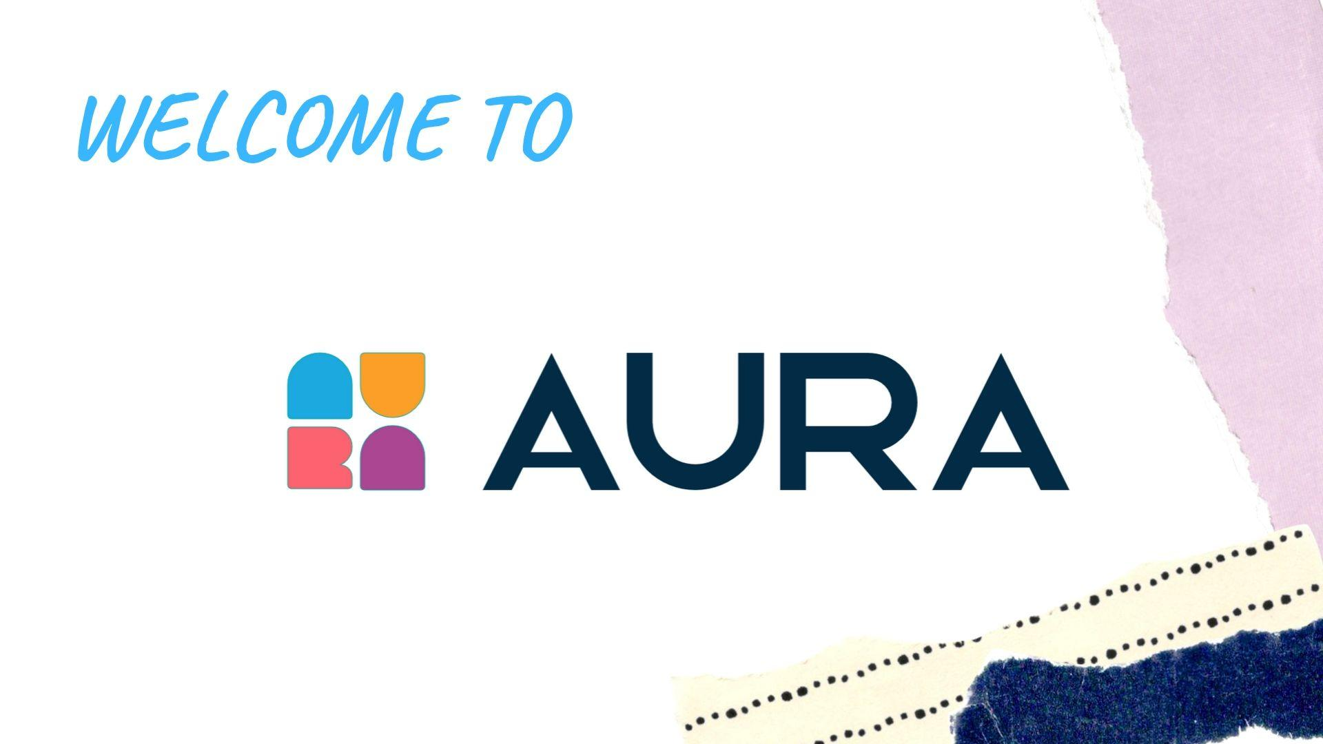
Notes:
1. What are you wearing now?
2. What kind of clothes do you usually wear?
3. Are clothes important to you?
4. Do you spend much money on clothes? *

Slide 2
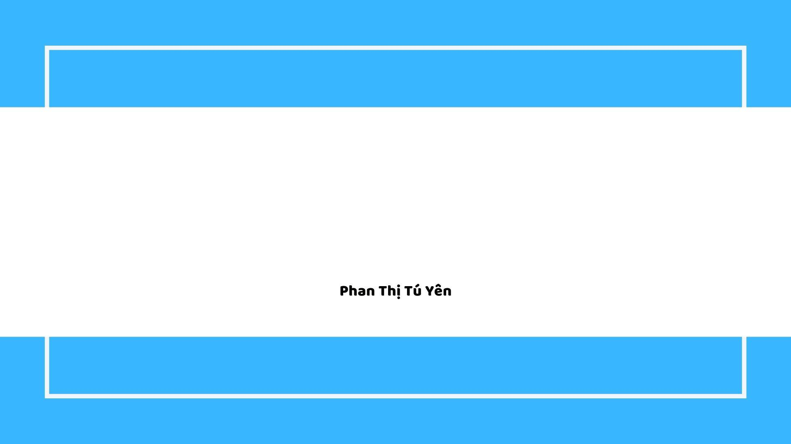
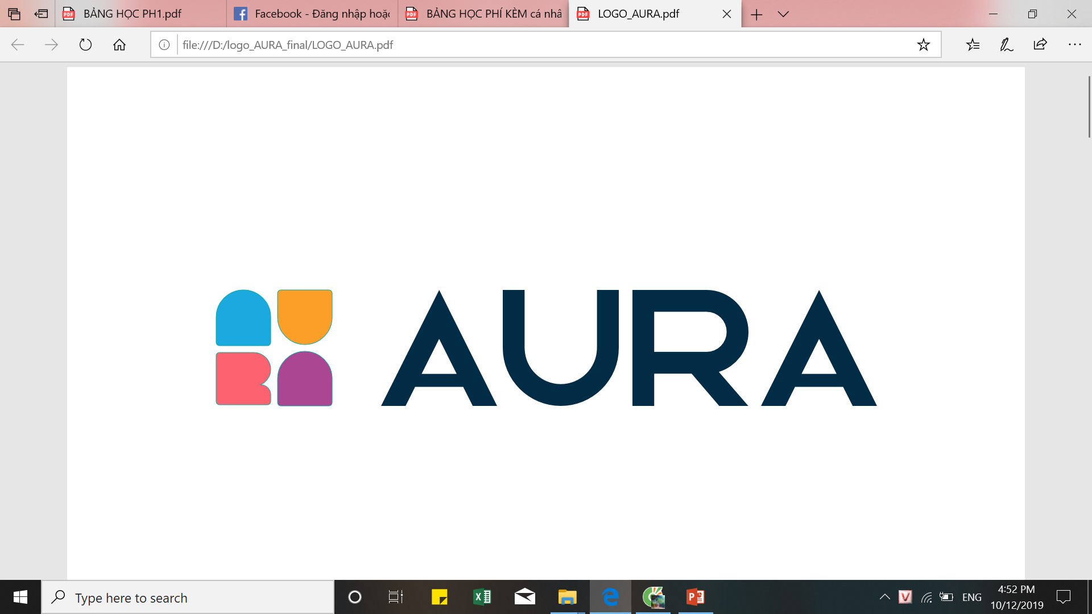
ACTIVITY Day 2
Teacher: Mr Minh

Slide 3

Content
1. Article
a/an/the
2. Revision
Describing someone in your family.
3. Extra Vocabulary
Clothes
4. Grammar
Countable and Uncountable nouns
5. Activity
Sing if you lose

Slide 4


1. A/an/the
Phụ âm
“eu” & “uni”
A cat, A bird, A doctor
A
A European, A university
“ue oai”
“h” câm
An egg, An orange
AN
An hour
Danh từ đã xác định
Danh từ duy nhất
I ate an apple yesterday. The apple was good.
THE
The world, the sky, the earth
Notes:
every student gives me 4 examples with a/an
do not repeat words of ur friends

Slide 5
2. Describing people
1. Can you tell me about your family?
2. How many members are there in your family? Who are they?
3. Do you have any brothers or sisters? Tell me more about them/ her/ him.
4. How old is your mother/father? What does he/she do?
5. Do you usually spend time gathering with your family? ***

Slide 6
2. Describing a person in your family
1. Who is that?
2. What is she/he looks like?
3. What does he/she do?
4. What is her/his personality?
5. Something about them makes you admire. (optional)

Slide 7
4. Countable and uncountable nouns
tea/coffee
lemonade
orange juice
bread
water
Notes:
sacks of rice

Slide 8
4. Countable and uncountable nouns
a glass of
a cup of
a bottle of
a loaf of
tea/coffee
lemonade
orange juice
bread
water
Notes:
2 loaves of bread
little money/time
a lot of/much money/time

Slide 9
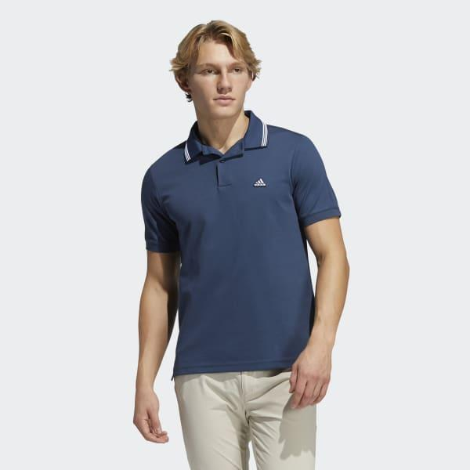
3. Vocabularies about Clothes:
polo shirt

Slide 10
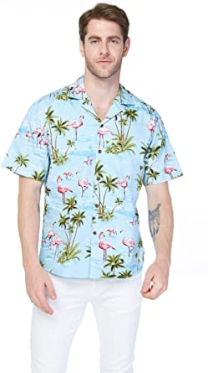
3. Vocabularies about Clothes:
hawaiian shirt = aloha shirt
Notes:
/həˌwaɪ.ən/

Slide 11
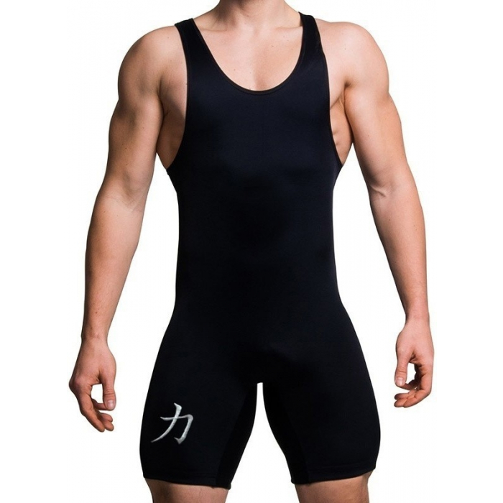
3. Vocabularies about Clothes:
singlet
Notes:
/ˈsɪŋ.ɡlət/

Slide 12
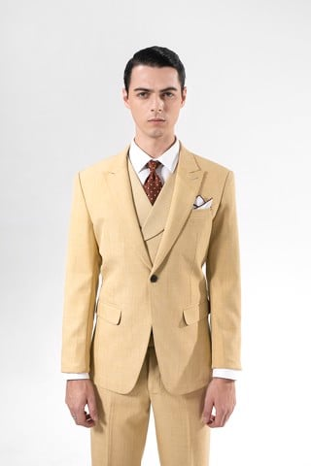
3. Vocabularies about Clothes:
Vest = Suit

Slide 13
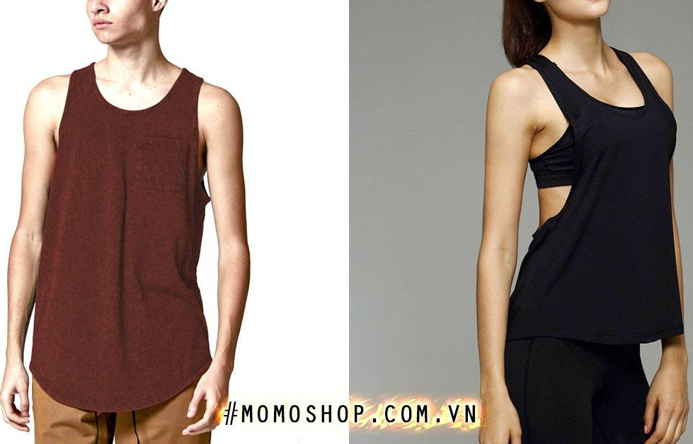
3. Vocabularies about Clothes:
Tank top

Slide 14
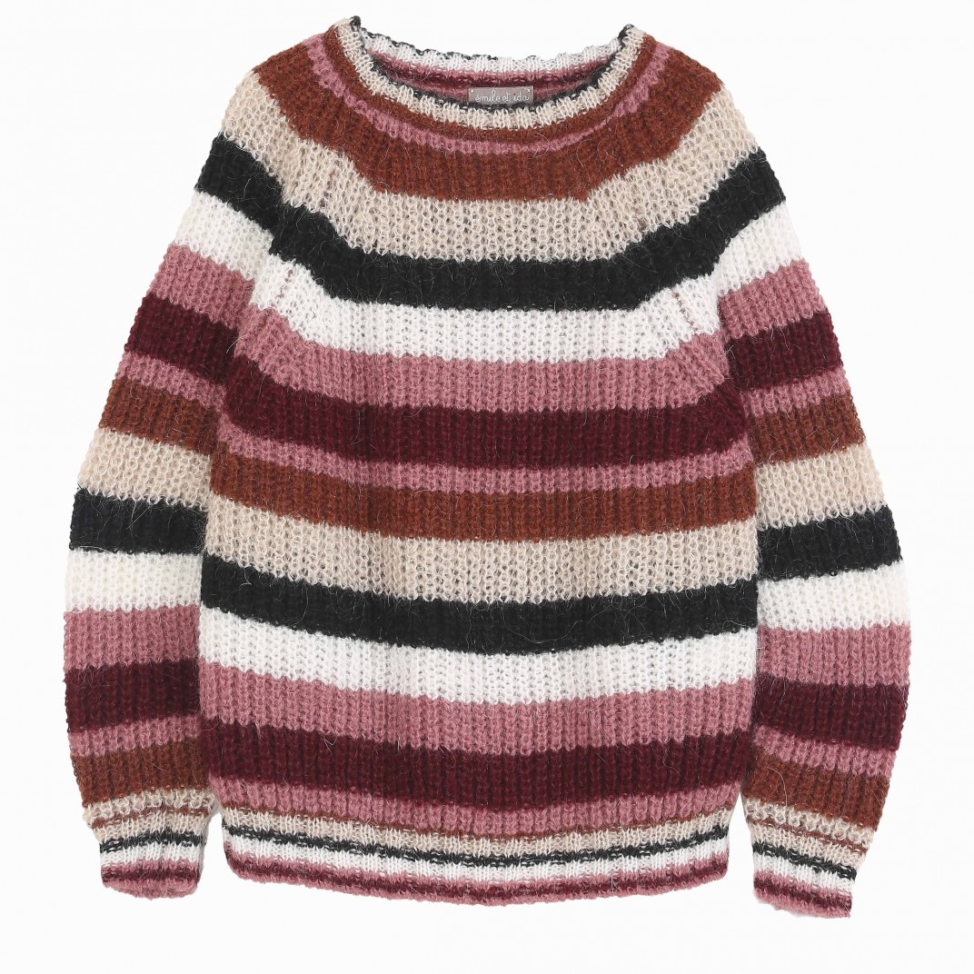
3. Vocabularies about Clothes:
jumper

Slide 15
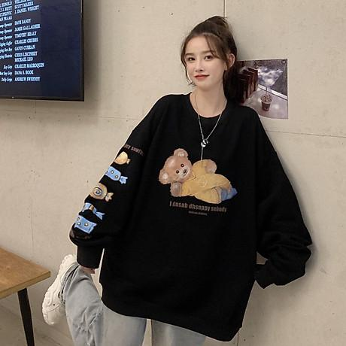
3. Vocabularies about Clothes:
sweater

Slide 16
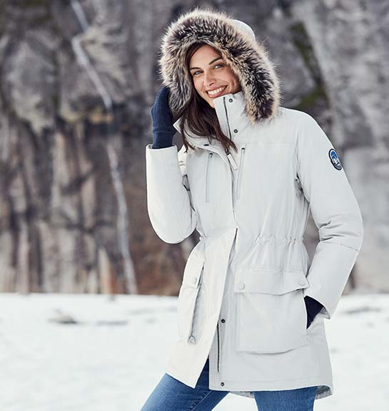
3. Vocabularies about Clothes:
Winter coat

Slide 17
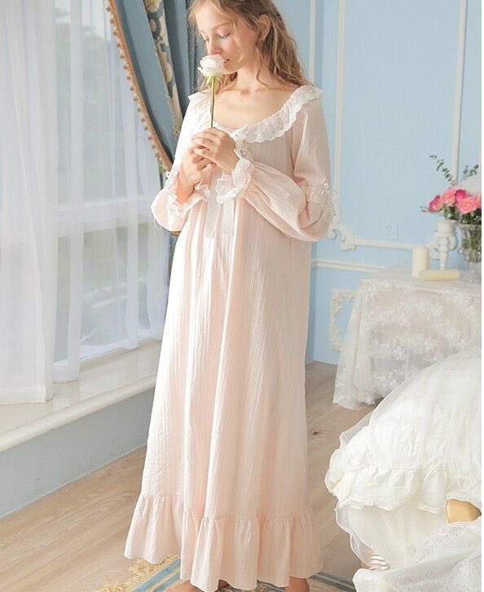
3. Vocabularies about Clothes:
Sleepwear = sleeping dress

Slide 18
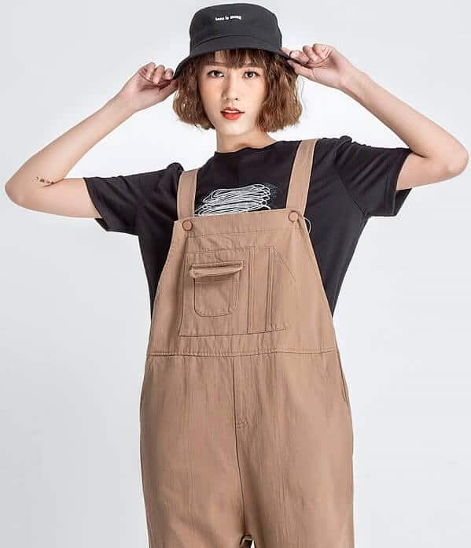
3. Vocabularies about Clothes:
overalls

Slide 19
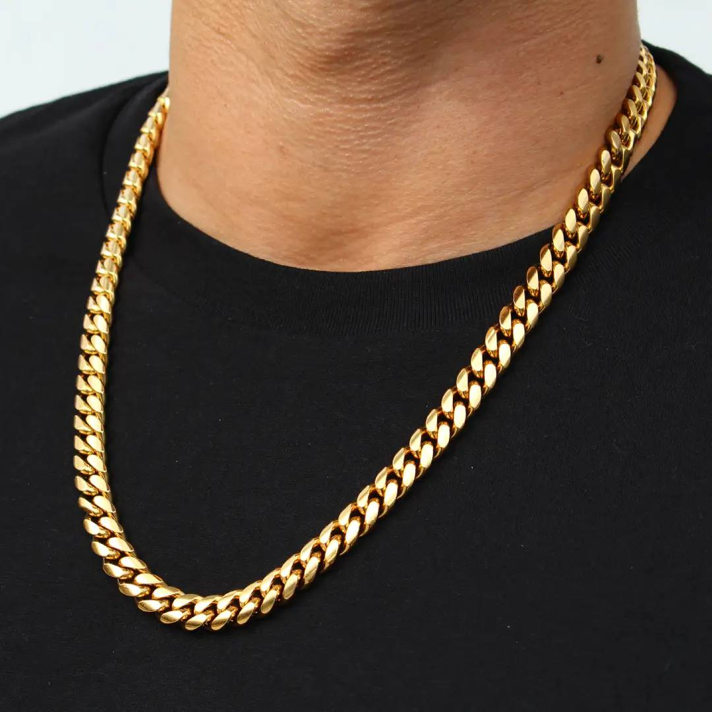
3. Vocabularies about Accessories:
Chain = necklace
Notes:
/tʃeɪn/
/ˈnek.ləs/

Slide 20
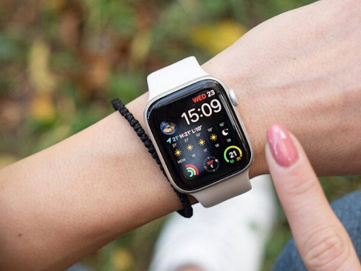
3. Vocabularies about Accessories:
watch

Slide 21
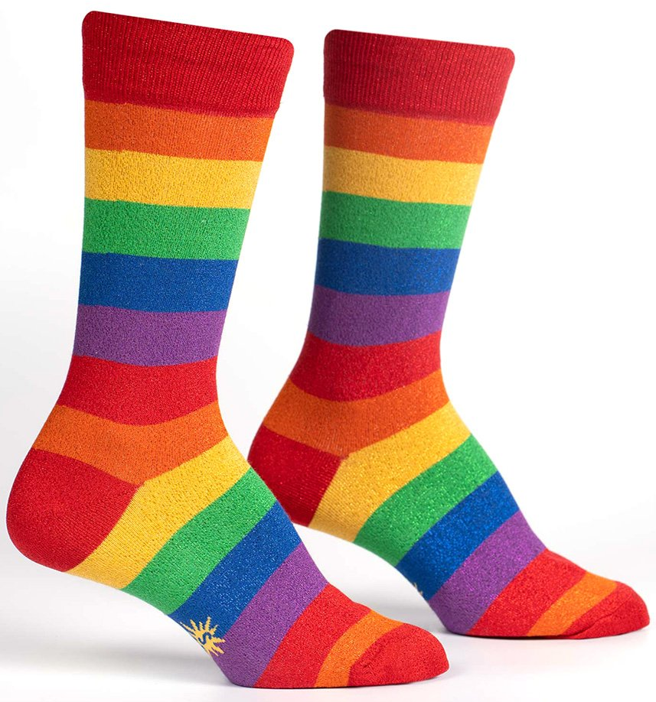
3. Vocabularies about Accessories:
Socks = Stockings

Slide 22
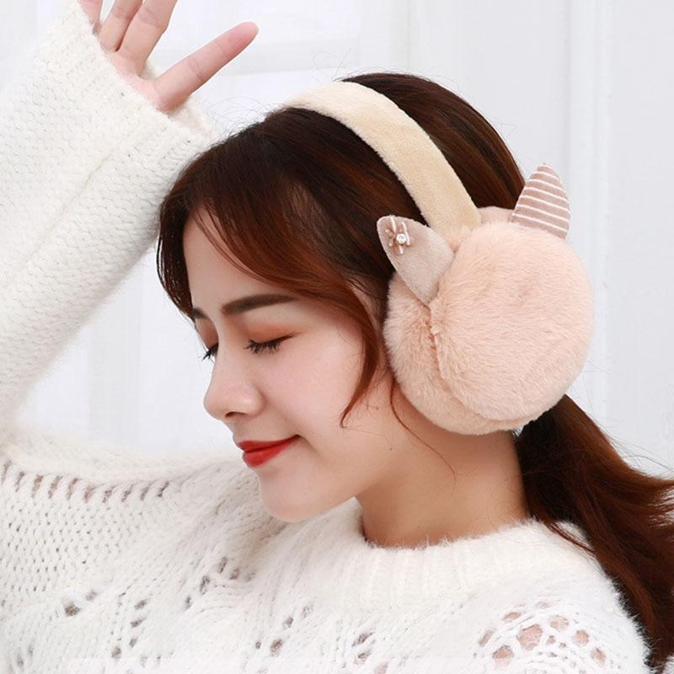
3. Vocabularies about Accessories:
earmuffs
Notes:
/ˈɪə.mʌfs/

Slide 23
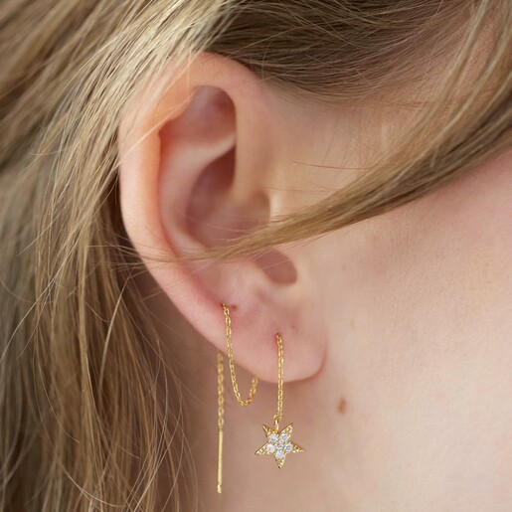
3. Vocabularies about Accessories:
earrings

Slide 24
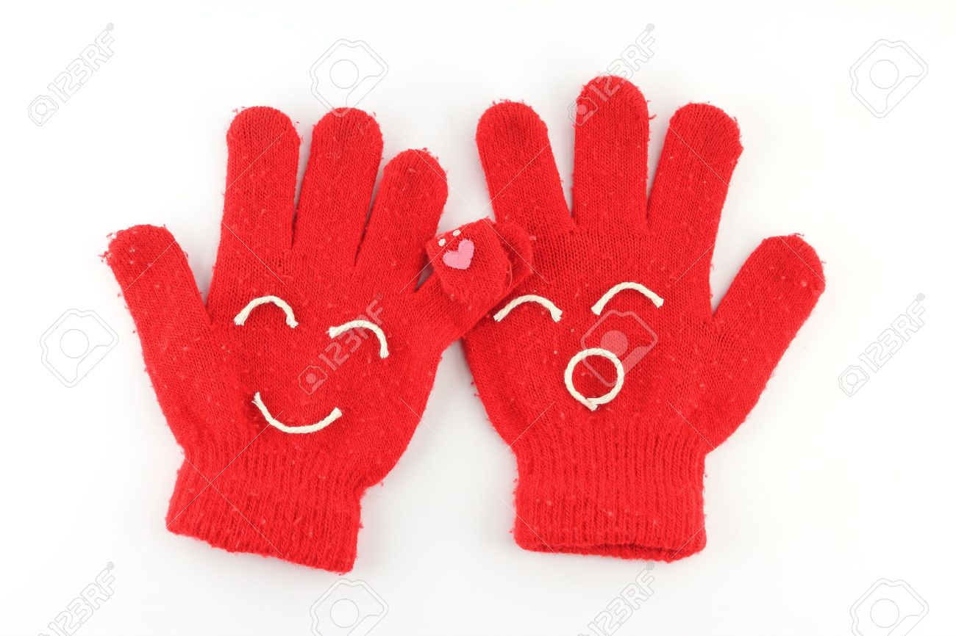
3. Vocabularies about Accessories:
Gloves = Mittens
Notes:
/ɡlʌv/
/ˈmɪt.ən/

Slide 25
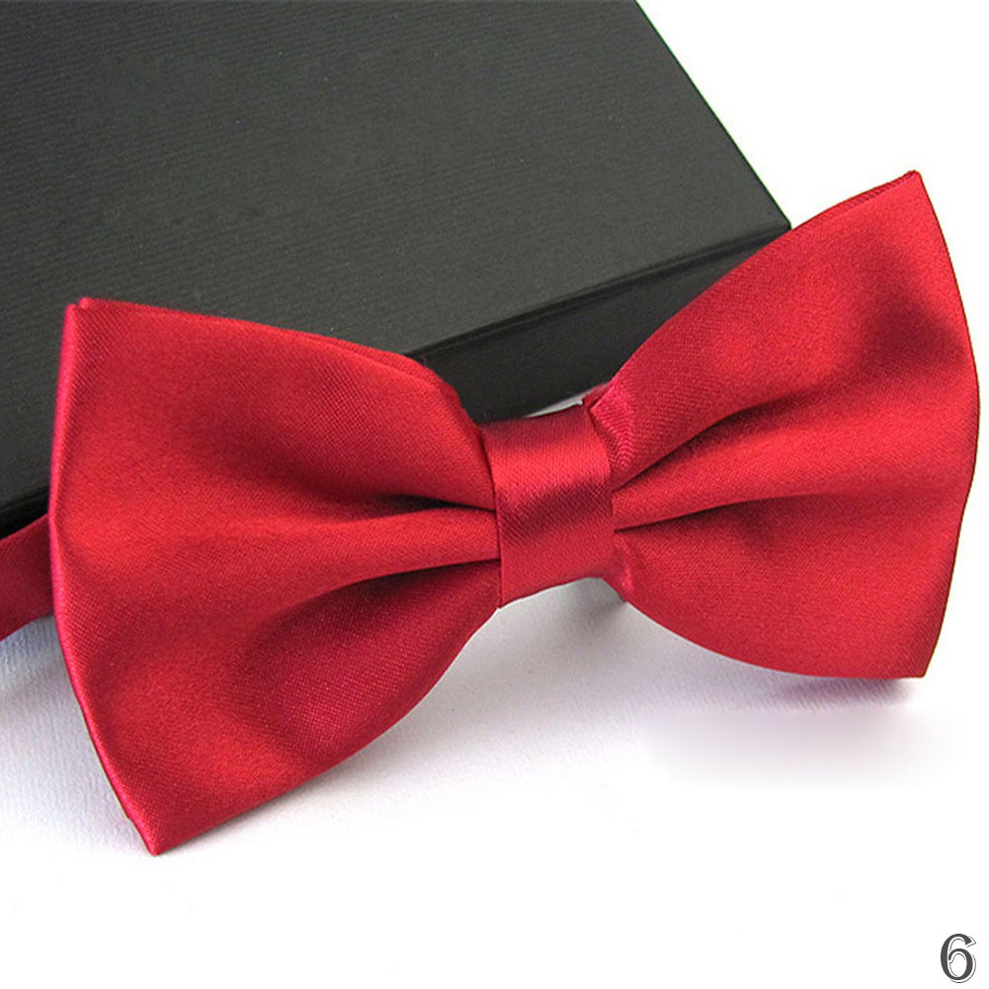
3. Vocabularies about Accessories:
bowtie
Notes:
/ˌbəʊ ˈtaɪ/

Slide 26
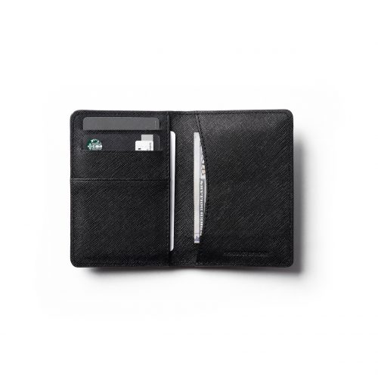
3. Vocabularies about Accessories:
Purse = wallet

Slide 27
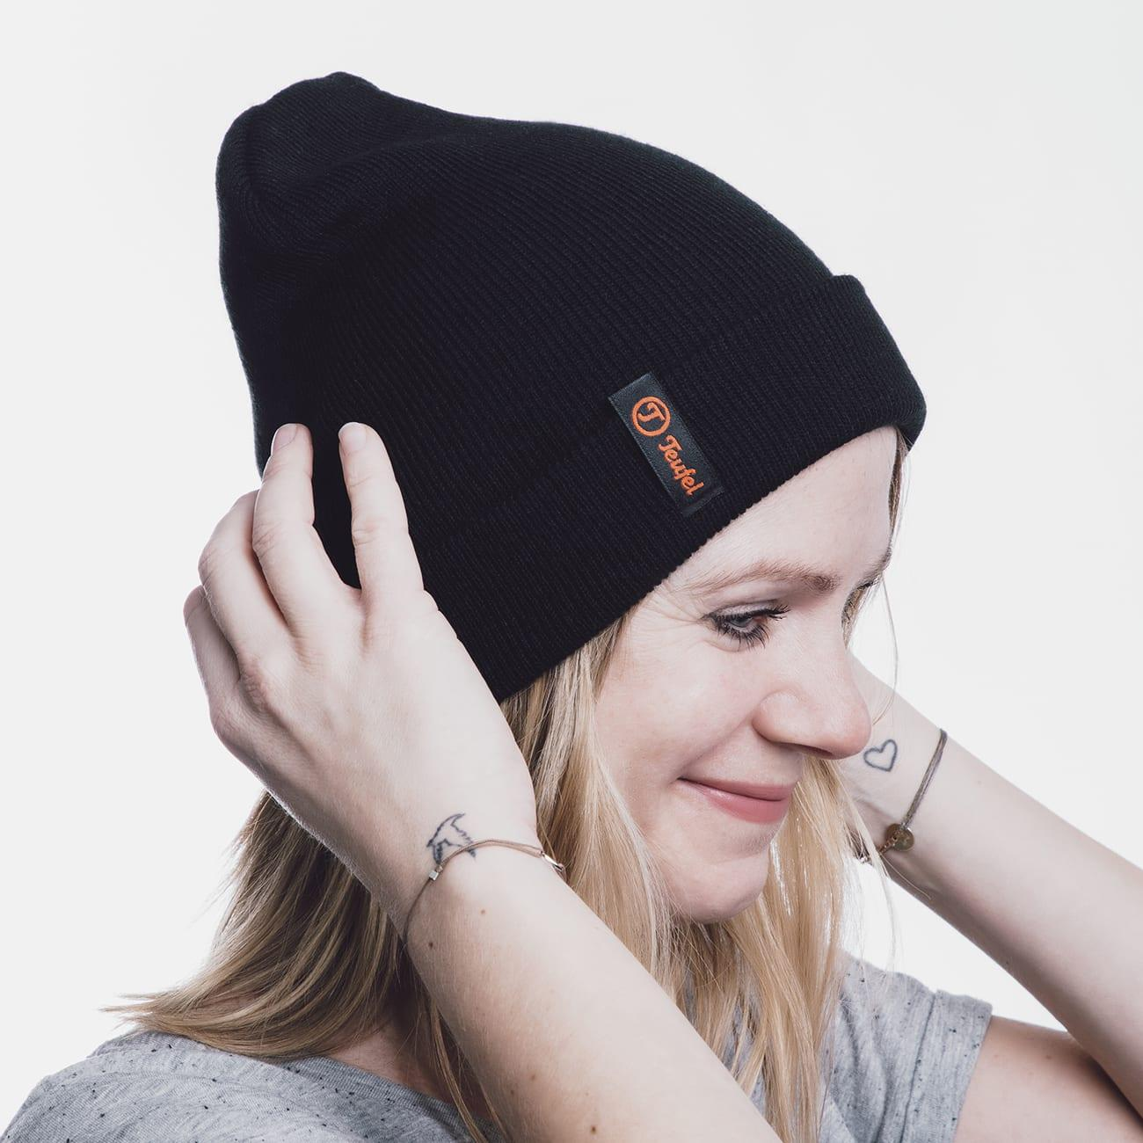
3. Vocabularies about Hat:
beanie
Notes:
/ˈbiː.ni/

Slide 28
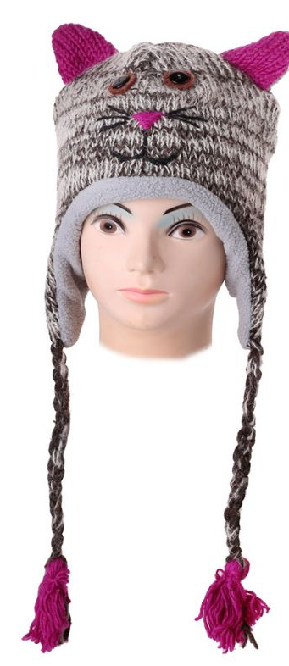
3. Vocabularies about Hat:
Woolen hat

Slide 29
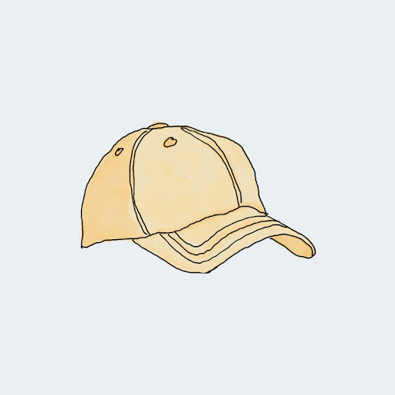
3. Vocabularies about Hat:
cap

Slide 30
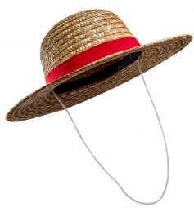
3. Vocabularies about Hat:
Straw hat

Slide 31
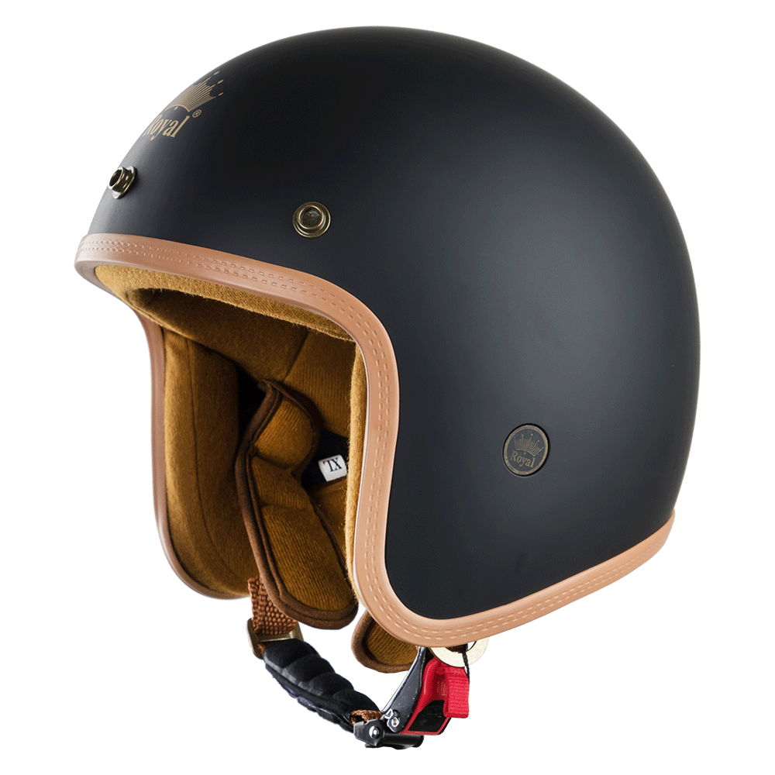
3. Vocabularies about Hat:
helmet

Slide 32
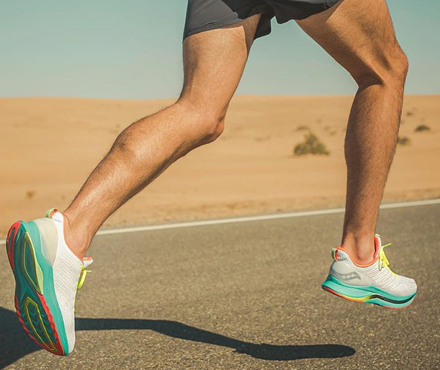
3. Vocabularies about Shoes:
Running shoes

Slide 33
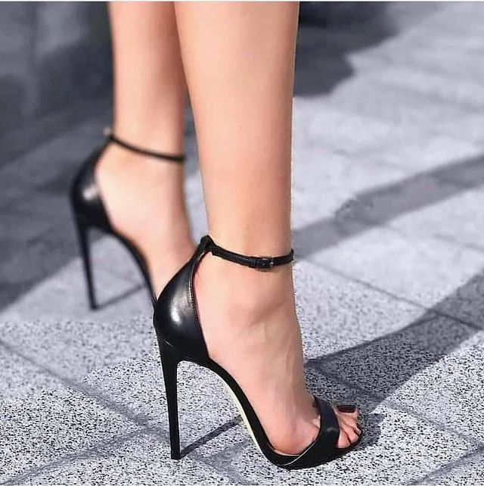
3. Vocabularies about Shoes:
High heels

Slide 34
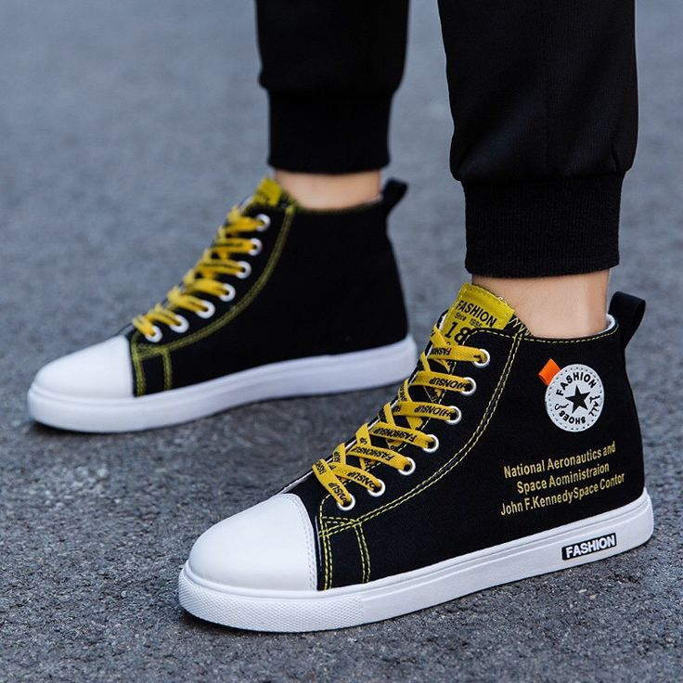
3. Vocabularies about Shoes:
High tops

Slide 35
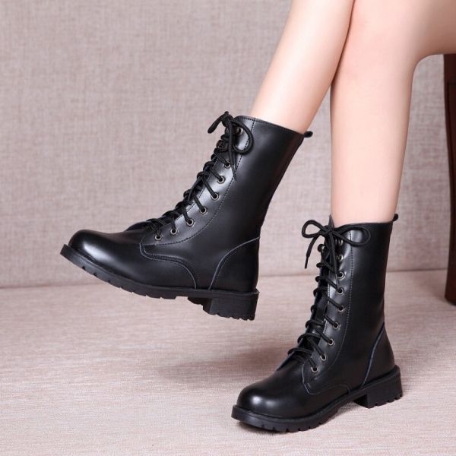
3. Vocabularies about Shoes:
boots

Slide 36
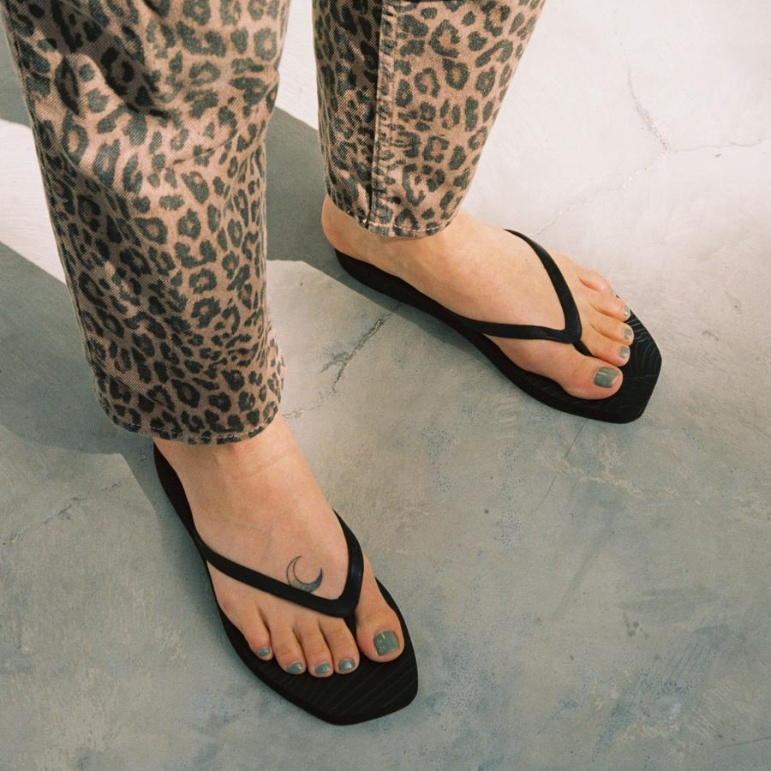
3. Vocabularies about Shoes:
Flip flop

Slide 37
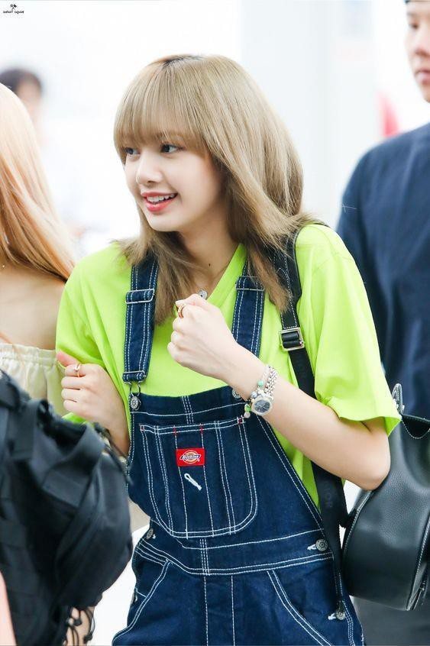

Slide 38
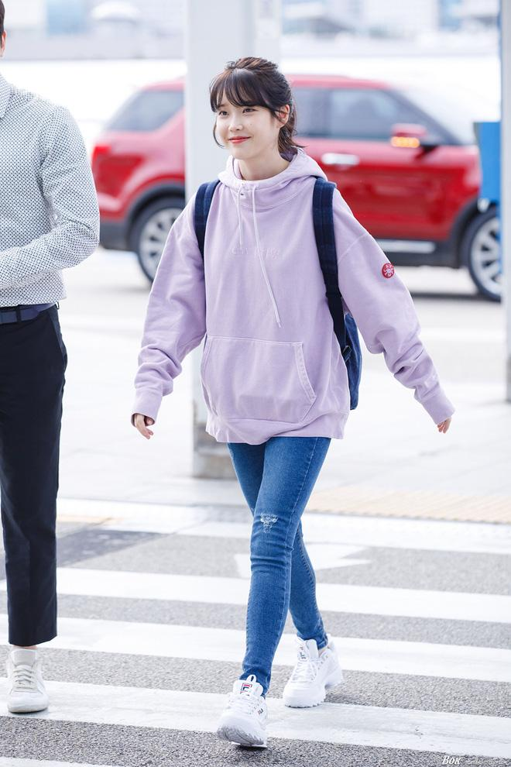

Slide 39
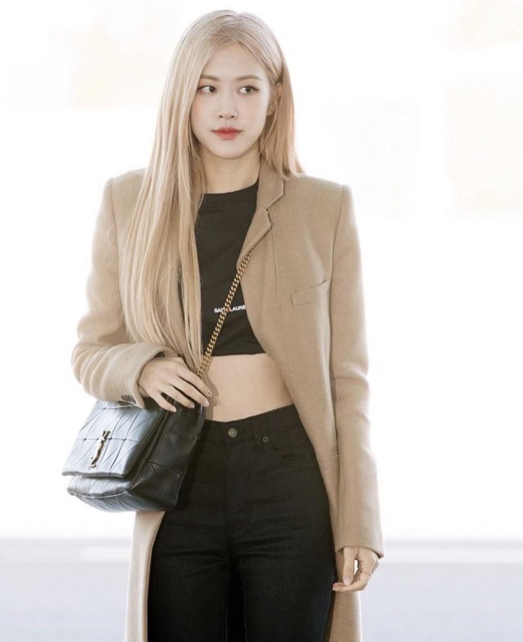

Slide 40
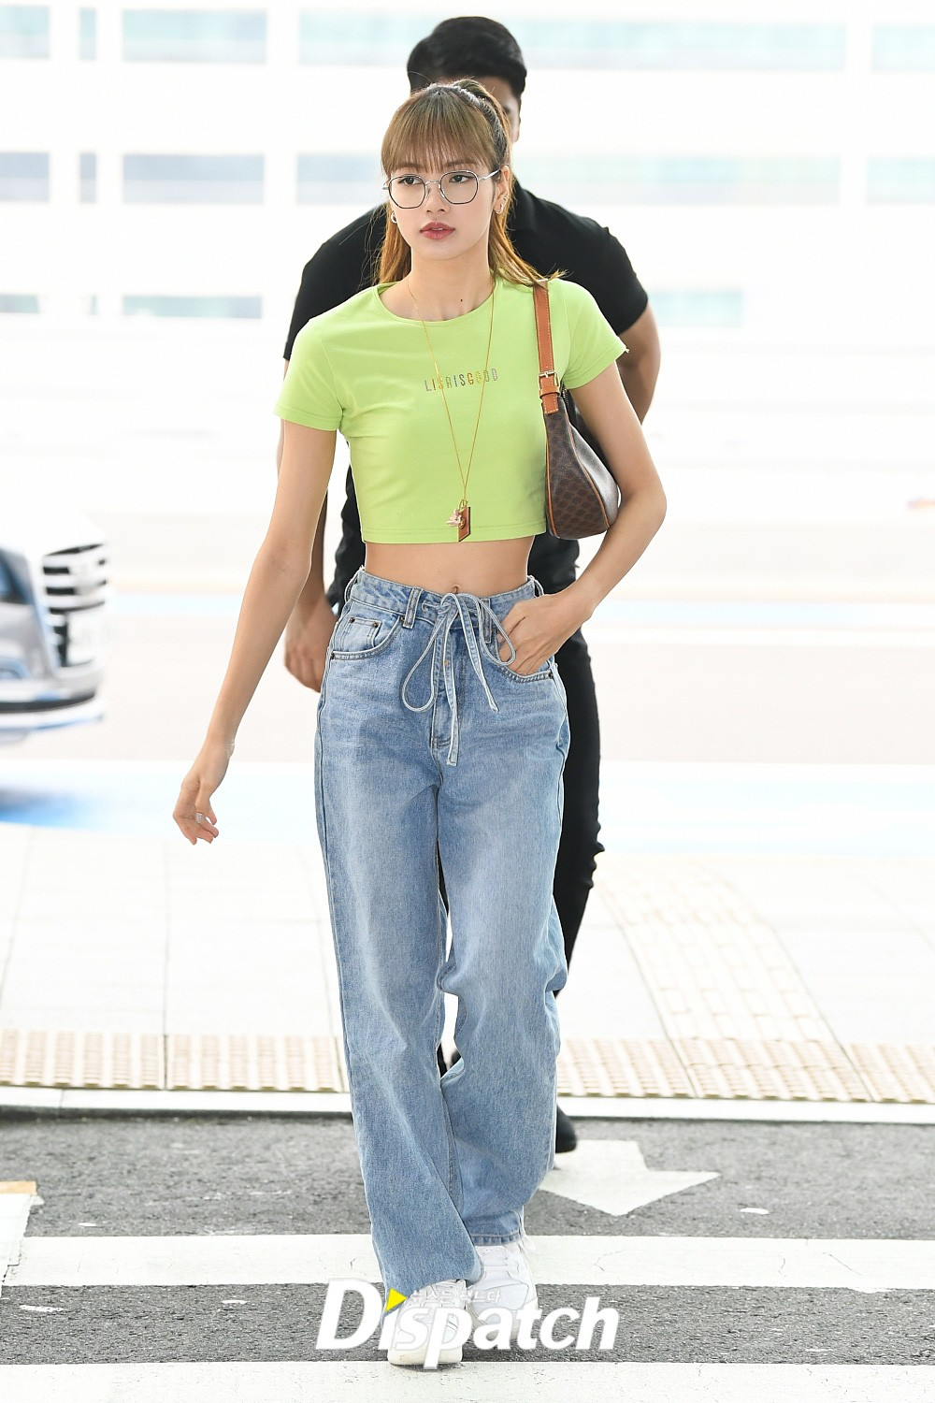

Slide 41
3. Vocabularies about Clothes:
+ Clothes: polo shirt, Hawaiian shirt, singlet, vest, tank-top, blazer, jumper, sweater, winter coat, sleeping dress, one-piece bathing suit, suits, overalls…
+ Accessories: chain (necklace), watch, stockings/socks, earmuffs, earrings, bowtie, mittens, purse, bell-chain…
+ Type of hats: beanie, woolen hat, cap, beret, straw hat, helmet…
+ Type of shoes: running shoes, high heels, high-tops, boots, flip-flops…
+ Men’s clothing:
+ Women’s clothing:

Slide 42
5. Activity
Look and guess
hawaiian shirt = aloha shirt
Running shoes
Chain = necklace
Socks = Stockings

Slide 43
5. Activity
Look and guess
helmet
singlet
High heels

Slide 44
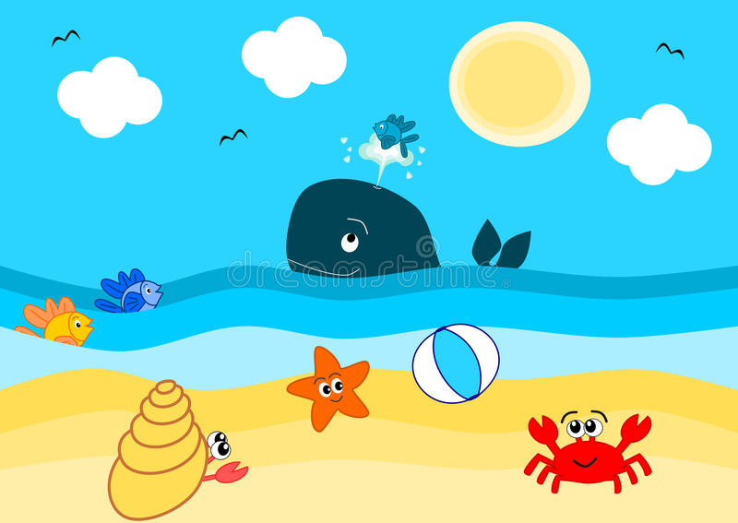
5. Activity
Imagine that you have summertime on the beach, what will you bring?
If I have summertime on the beach, I will bring …..

Slide 45
Thank you and see you next time!

